Slide 1
Introduction to Diseases

Slide 2
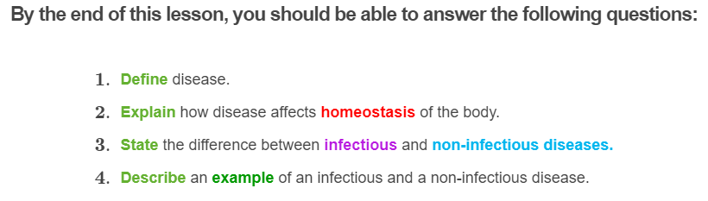


Slide 3
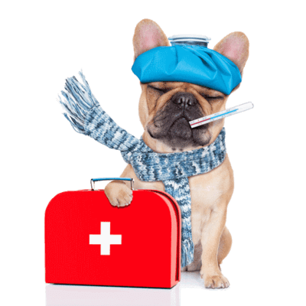
A disease is any change in the body that impairs the normal function of an individual.
Diseases can disrupt the normal homeostasis of our body.

Slide 4
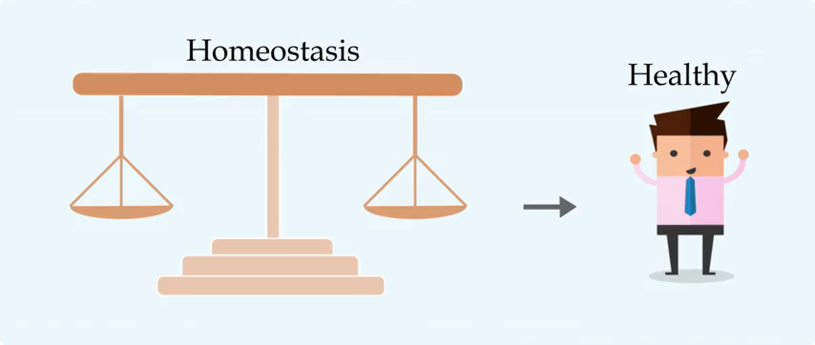
Imbalance in homeostasis
An imbalance in homeostasis or an inability of the body to restore a functional and stable internal environment could also lead to a state of disease, like in cancer.
In other words, a disruption to homeostasis can make you sick!

Slide 5
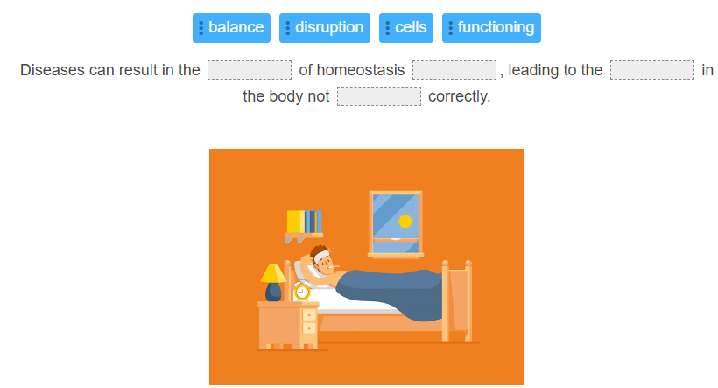

Slide 6
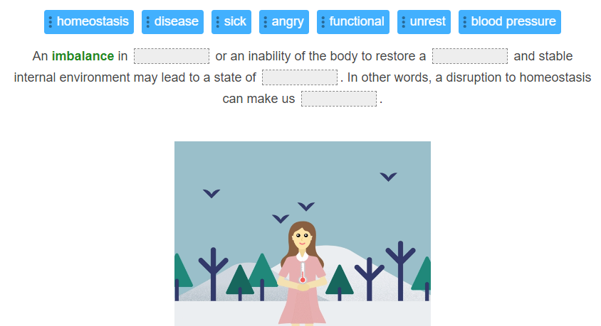

Slide 7
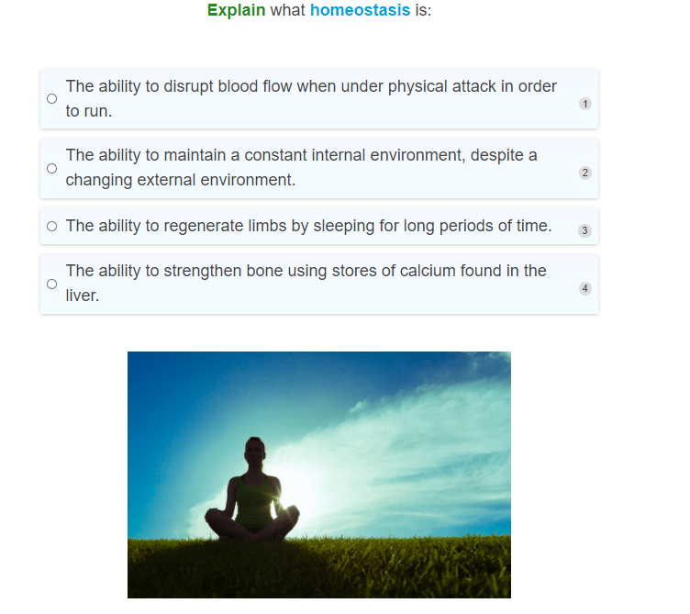

Slide 8
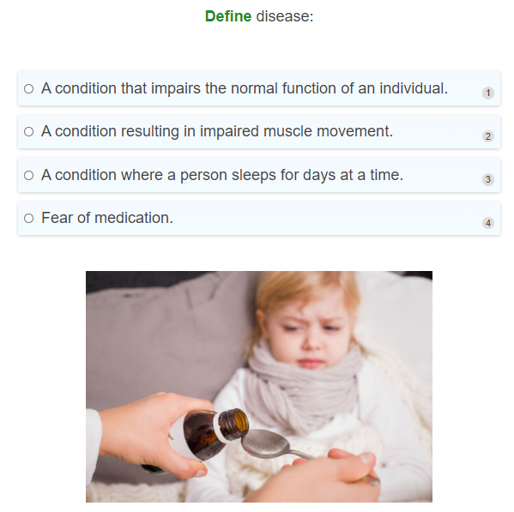

Slide 9

Diseases can be infectious or non-infectious.
Infectious diseases are caused by an agent or pathogen, that can be passed between organisms, hence the name "infectious." The infected organism is known as the host. If you have ever had a cold, you have been a host to a virus.
Non-infectious diseases, on the other hand, aren't caused by pathogens and can't be transmitted from one organism to another. For instance, you couldn't catch skin cancer off a friend because cancer isn't able to be passed on like a cold.

Slide 10
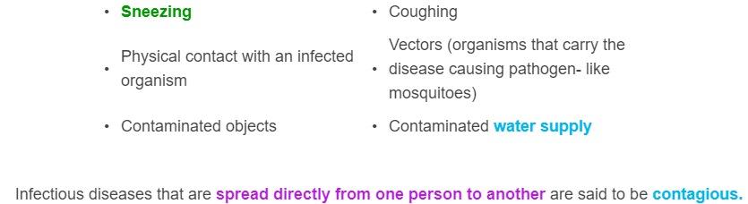


Infectious diseases can be spread in many ways. These include:

Slide 11
There are many different types of infectious diseases!
Infectious diseases are caused by pathogens such as viruses, bacteria, and fungi. We will look at these different types of pathogens in more detail in the next few Smart Lessons!
When a pathogen infects a person (called the host) they can cause damage and impair the function of the cells in our body, which disrupts the homeostasis of our bodies.

Slide 12
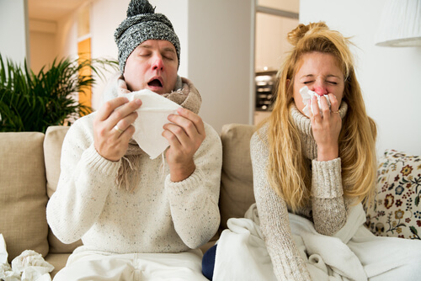
Let's look at some examples of infectious diseases!
You are probably very familiar with the common cold! Sneezing, a sore throat, runny noses and a dry cough - these are some symptoms that you probably find familiar.

Slide 13
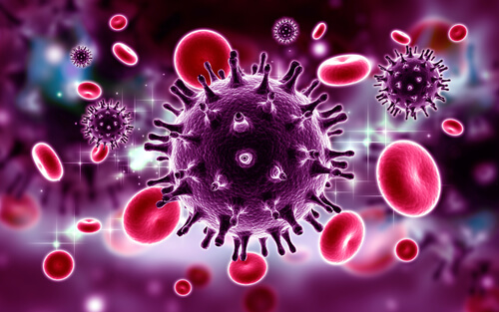
The common cold
The common cold is caused by a virus (we will learn about viruses later on in the module).
It can be spread by direct contact with an infected person or by inhaling the virus after individuals sneeze or cough. That's why it is always important to cover your mouth!

Slide 14

Food poisoning
Sometimes after eating food that has been contaminated with pathogens, you may suddenly feel unwell and vomit or get diarrheoa!
This is called food poisoning and is usually caused by bacteria. An example of a bacteria that can cause food poisoning is Escherichia coli, or E. coli for short.
This is an example of infectious disease. The disease is spread through people eating the contaminated food. This then causes the person who ate the food to become sick!

Slide 15

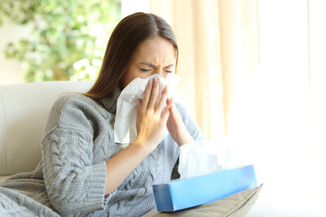
Some ways to reduce the chance of getting or spreading germs!
• | Washing your hands often (especially after going to the bathroom and before preparing food.)
• | Stay at home if you have signs and symptoms of an infection to avoid spreading the disease.
• | Cover your mouth and nose when you are sneezing or coughing. (Use a tissue!)
• | Maintaining proper hygiene standards and keeping clean - like brushing your teeth twice a day or taking a shower.

Slide 16
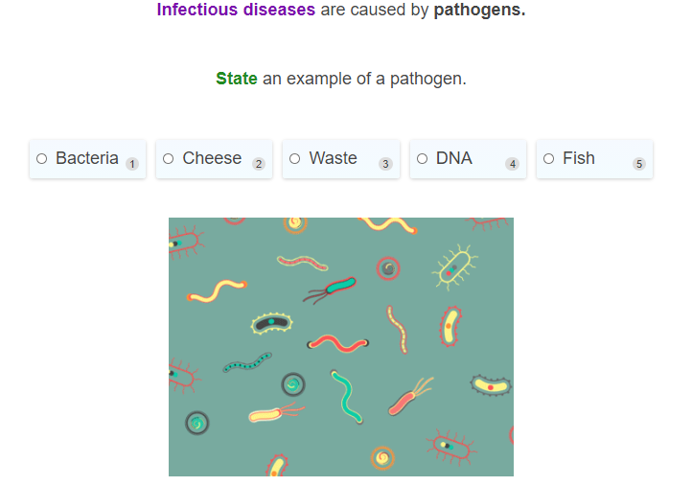

Slide 17
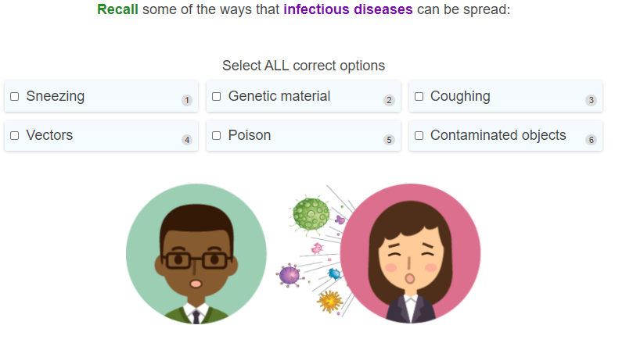

Slide 18
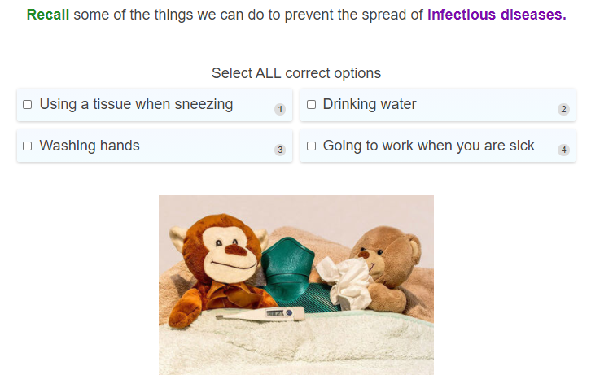

Slide 19
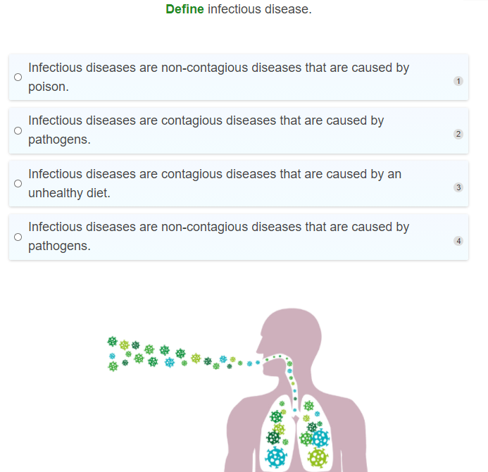

Slide 20


Non infectious diseases
Non-infectious diseases cannot be spread from one person to another and are therefore not contagious.
These diseases are not caused by pathogens and usually result from genetic, lifestyle, unhealthy diets, or environmental factors.

Slide 21
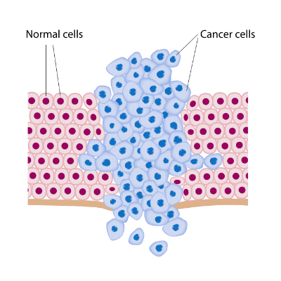

Cancer
For example, cancer is a non-infectious disease. It is not contagious.
Cancer is a disease that is formed when cell growth gets out of control. Usually the body can maintain a balance between cell growth and cell death.
However, when this balance is disrupted - cells can begin to uncontrollably grow without dying. This results in the growth of a mass of cells, which forms a tumour - known as cancer.

Slide 22
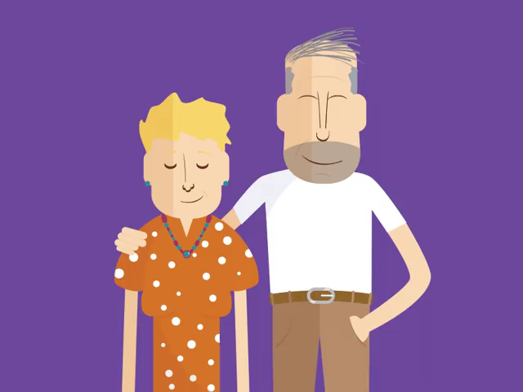
Risk factors for cancer
There are many risk factors for cancer - things that increase the likelihood of getting cancer. These include an older age, alcohol, pollution, smoking, diet, and mutations in your genes.

Slide 23
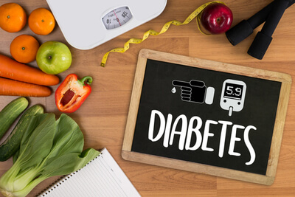
Diabetes is another example of a non-infectious disease.
Type 1 diabetes results in the cells in the pancreas being unable to produce or respond to a hormone called insulin.
Insulin is important for regulating your blood sugar levels after a meal. This disease is not contagious. It cannot be transmitted from person to person.

Slide 24
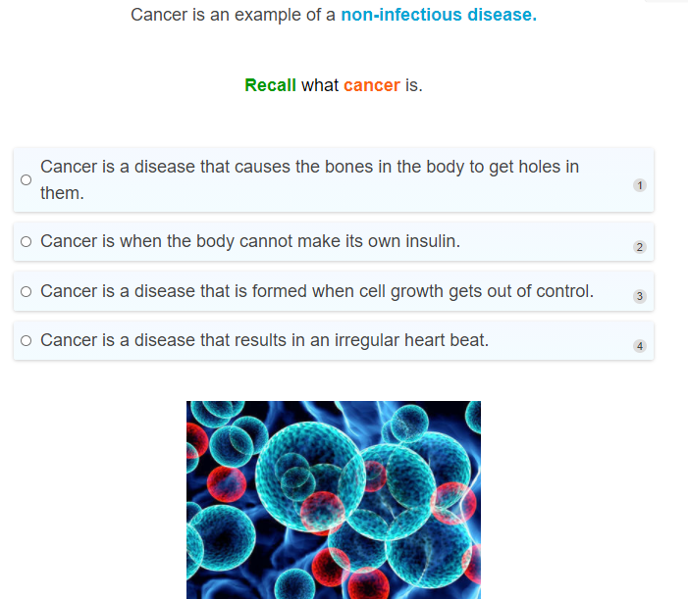

Slide 25
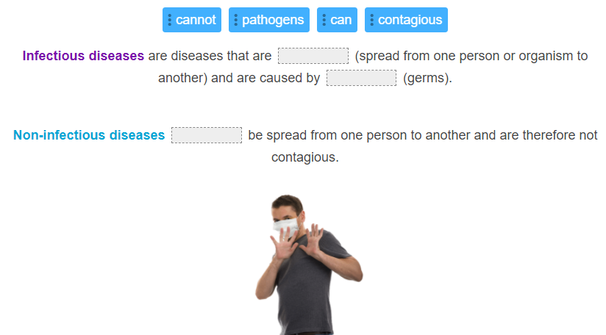

Slide 26
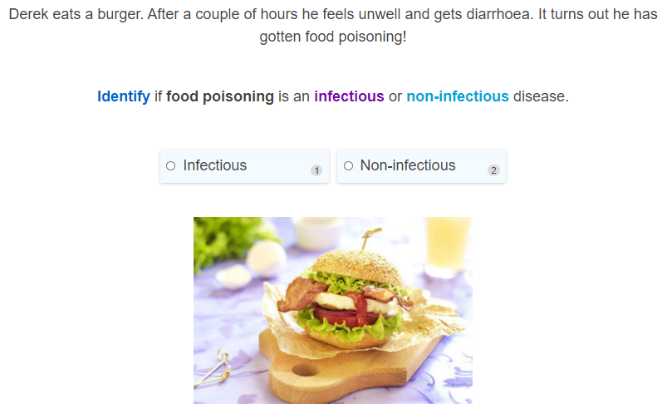

Slide 27
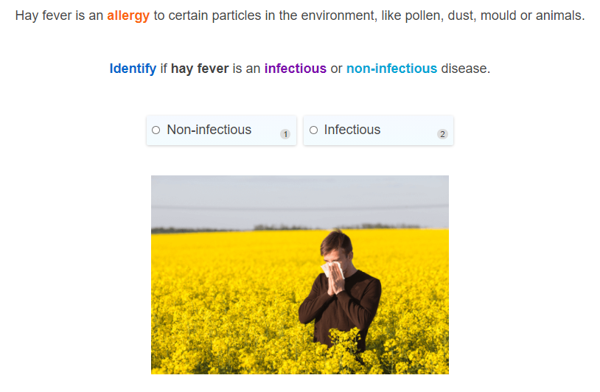

Slide 28
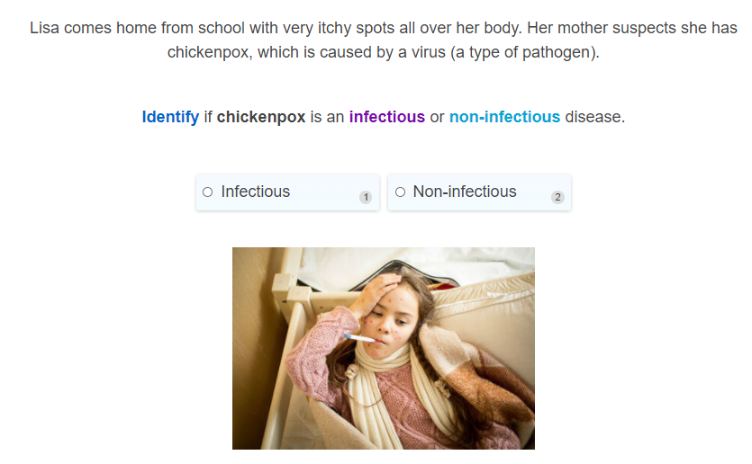

Slide 29
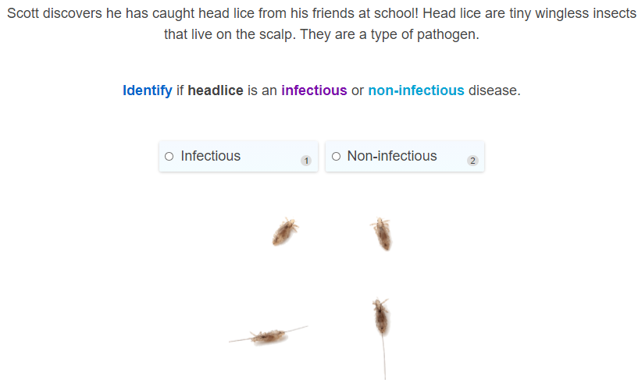

Slide 30
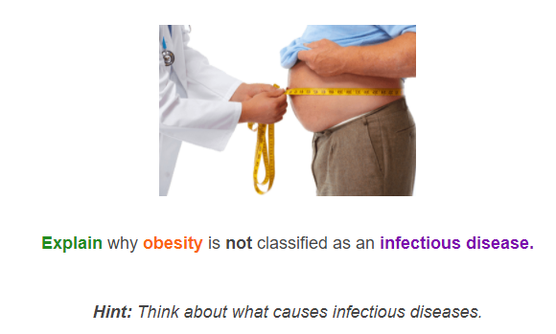

Slide 31
